Slide 1
Data Mining
Data
Qin Zhang
qinzhang@szu.edu.cn

Slide 2
Outline
Data Acquisition (数据获取)
- Web Scraping (网页抓取)
Data Labeling
Data Cleaning
Data Transformation
Feature Engineering
Data Part Summary

Slide 3
Flow Chart for Data Acquisition
Start a DM application
Have enough data?
Are there external datasets?
No
No
Yes
Yes
Discover or integrate data
Will cover later

Slide 4
Discover What Data is Available
Identify existing datasets
Find benchmark datasets to evaluate a new idea
E.g. A diverse set of small to medium datasets for a new hyper- parameter tuning algorithm
E.g. Large scale datasets for a very big deep neural network

Slide 5
Popular DM/ML datasets
MNIST: digits written by employees of the US Census Bureau
ImageNet: millions of images from image search engines
AudioSet: YouTube sound clips for sound classification
LibriSpeech: 1000 hours of English speech from audiobook
Kinetics: YouTube videos clips for human actions classification
KITTI: traffic scenarios recorded by cameras and other sensors
Amazon Review: customer reviews and from Amazon online shopping
SQuAD: question-answer pairs derived from Wikipedia
More at https://en.wikipedia.org/wiki/List_of_datasets_for_machine-learning_research

Slide 6
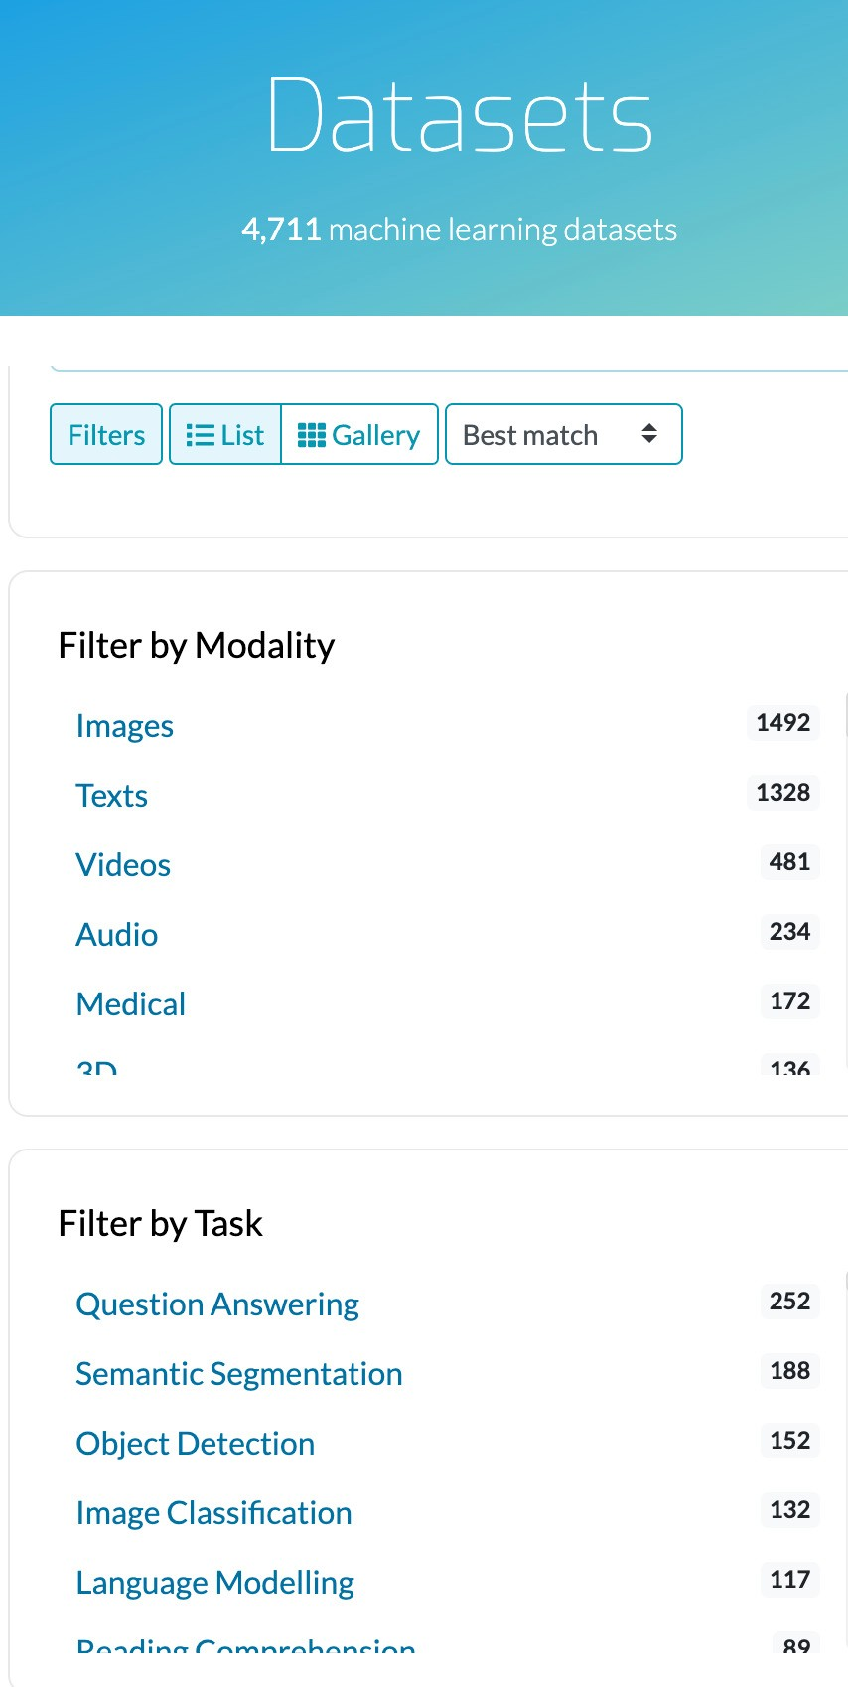
Where to Find Datasets
Paperswithcodes Datasets: academic datasets with leaderboard
Kaggle Datasets: ML datasets uploaded by data scientists
Google Dataset search: search datasets in the Web
Various toolkits datasets: tensorflow, huggingface
Various conference/company ML competitions
Open Data on AWS: 100+ large-scale raw data
Data lakes in your own organization

Slide 7
Datasets Comparison
 | Pros | Cons
Academic datasets | Clean, proper difficulty | Limited choices, too simplified, usually small scale
Competition datasets | Closer to real ML applications | Still simplified, and only available for hot topics
Raw Data | Great flexibility | Needs a lot of effort to process
You often need to deal with raw data in industrial settings
Data curation (数据管理) can be a big projection involving multiple teams. Processing pipeline, storage, legal issue, privacy,…

Slide 8
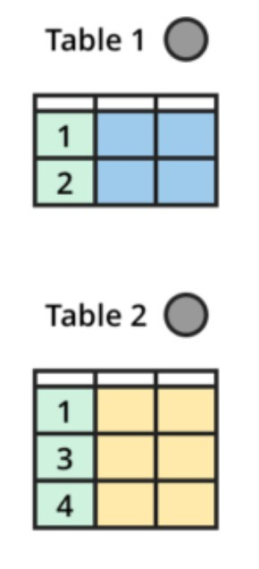
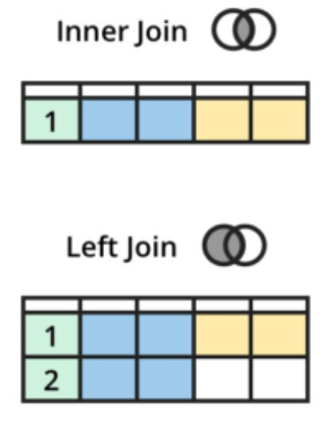
Data Integration
Combine data from multiple sources into a coherent dataset
Product data is often stored in multiple tables
E.g. a table for house information, a table for sales,
a table for listing agents
Join tables by keys, which are often entity IDs
Key issues: identify IDs, missing rows,
redundant columns, value conflicts

Slide 9
Flow Chart for Data Acquisition
Start a ML application
Have enough data?
Are there external datasets?
Have data generation methods
No
No
Yes
Yes
Yes
Discover or integrate data
Generate Data
Will cover later

Slide 10

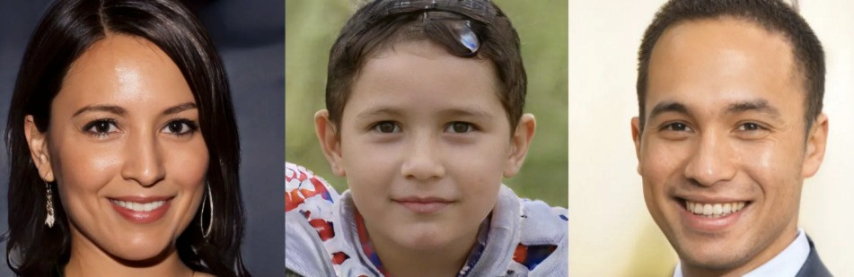
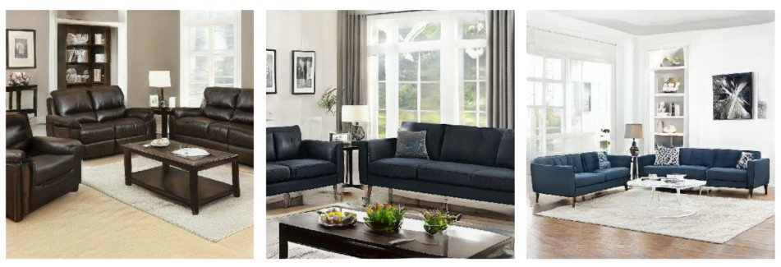

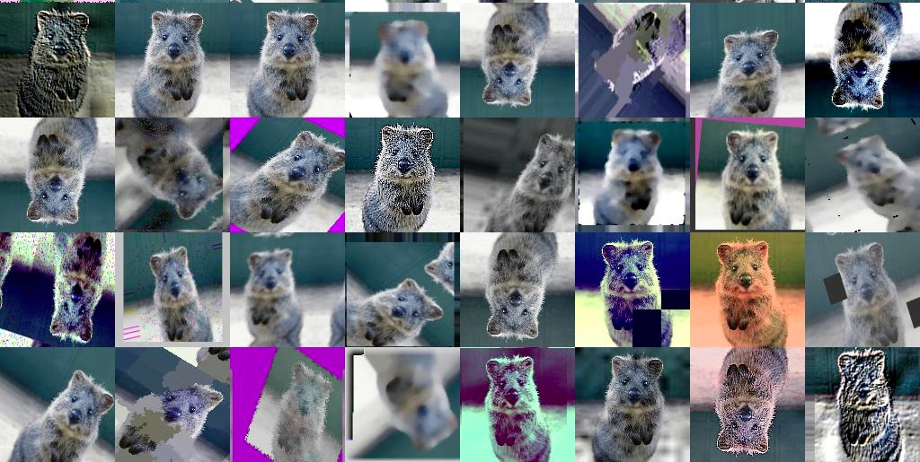

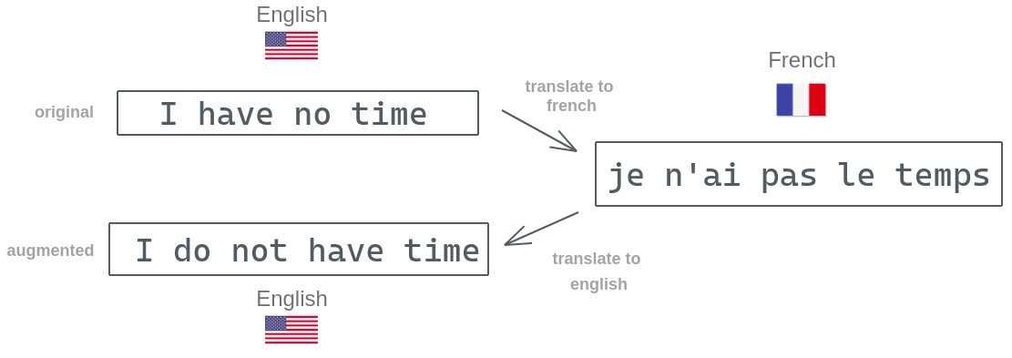
Generate Synthetic Data
Use GANs
Faces
Furnitures in living rooms
https://thispersondoesnotexist.com/
Gadde et al., ICCV’21
Data augmentations
Image augmentation
Back Translation
https://github.com/aleju/imgaug
https://amitness.com

Slide 11
Summary
Finding the right data is challenging
Raw data in industrial settings VS academic datasets
Data integration combines data from multiple sources
Data augmentation a common practice
Synthesizing data（合成数据） is getting popular

Slide 12
Outline
Data Acquisition
- Web Scraping (网页抓取)
Data Labeling
Data Cleaning
Data Transformation
Feature Engineering
Data Part Summary

Slide 13
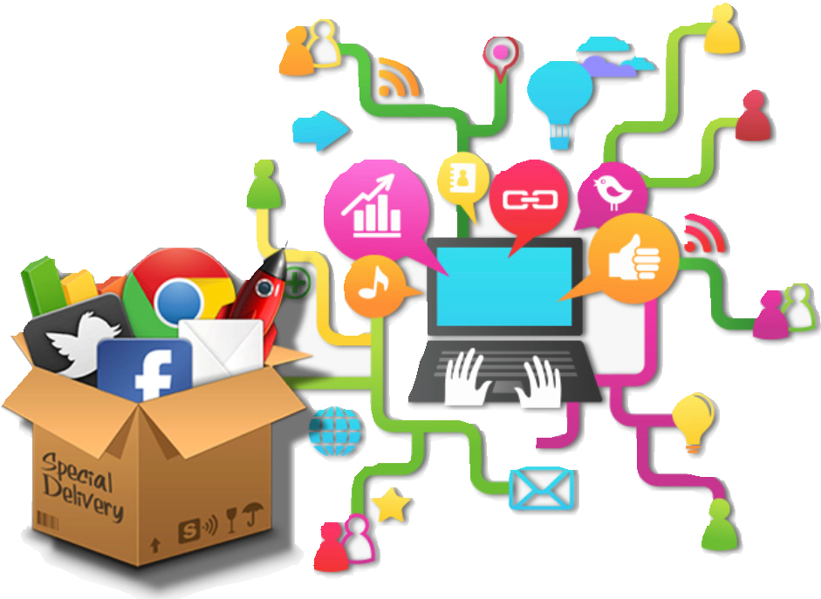
Web Scraping(网络抓取)
The goal is to extract data from website
Noisy, weak labels, can be spammy
Available at scale
E.g. price comparison/tracking website
Many ML datasets are obtained by web scraping
E.g. ImageNet, Kinetics
Web crawling VS scrapping
Crawling: indexing whole pages on Internet
Scraping: scraping particular data from web pages of a website
Image credit: Aaron Zappia

Slide 14
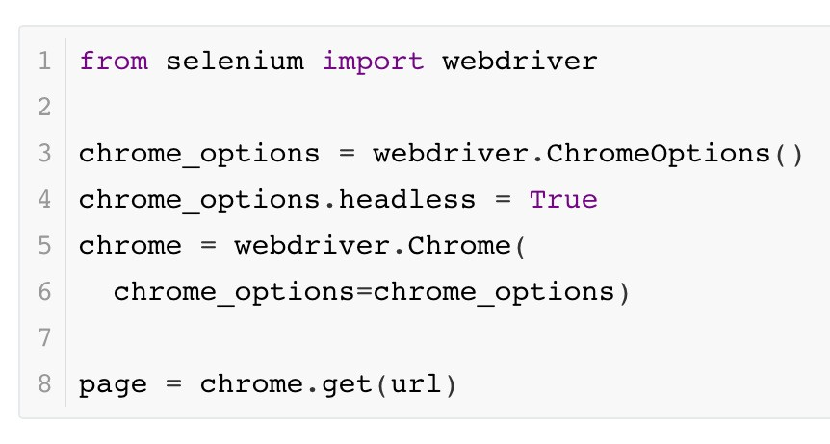
Tools
“curl” often doesn’t work
Website owners use various ways to stop bots
Use headless browser
You need a lot of new IPs, easy to get through public clouds
In all IPv4 IPs, AWS owns 1.75%, Azure 0.55%, GCP 0.25%

Slide 15
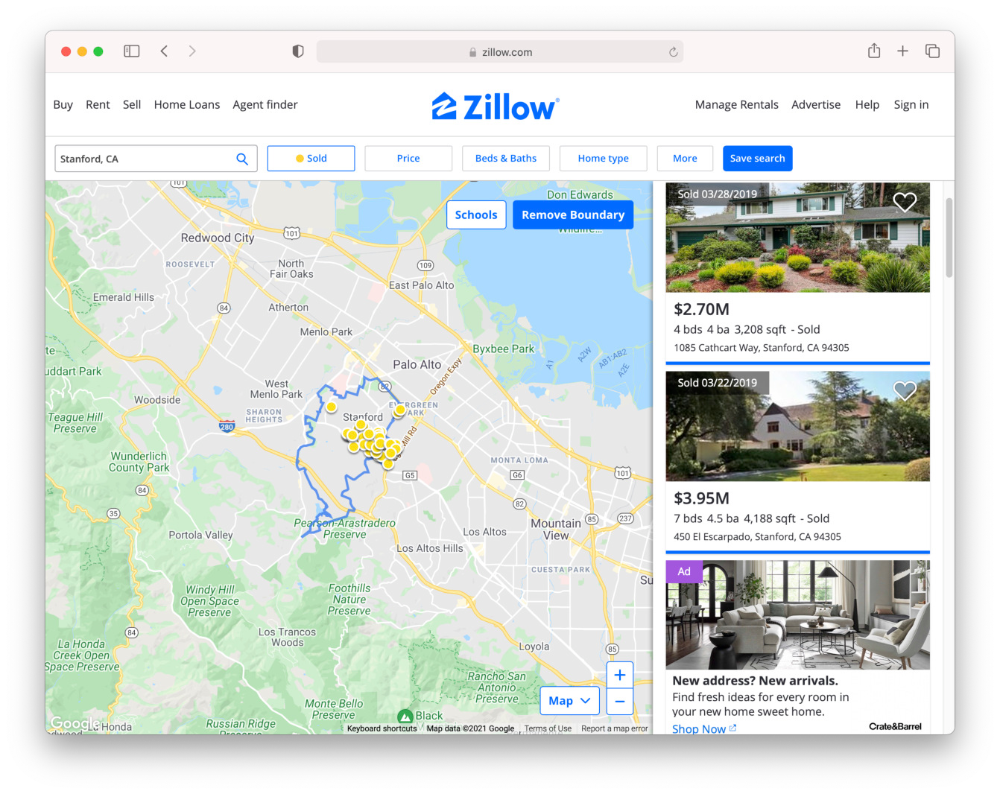
Case Study
Query houses sold in near Stanford
https://www.zillow.com/stanford-ca/sold/
https://www.zillow.com/stanford-ca/sold/ 2-p/
…
You can replace the city and state in the URL for other places

Slide 16
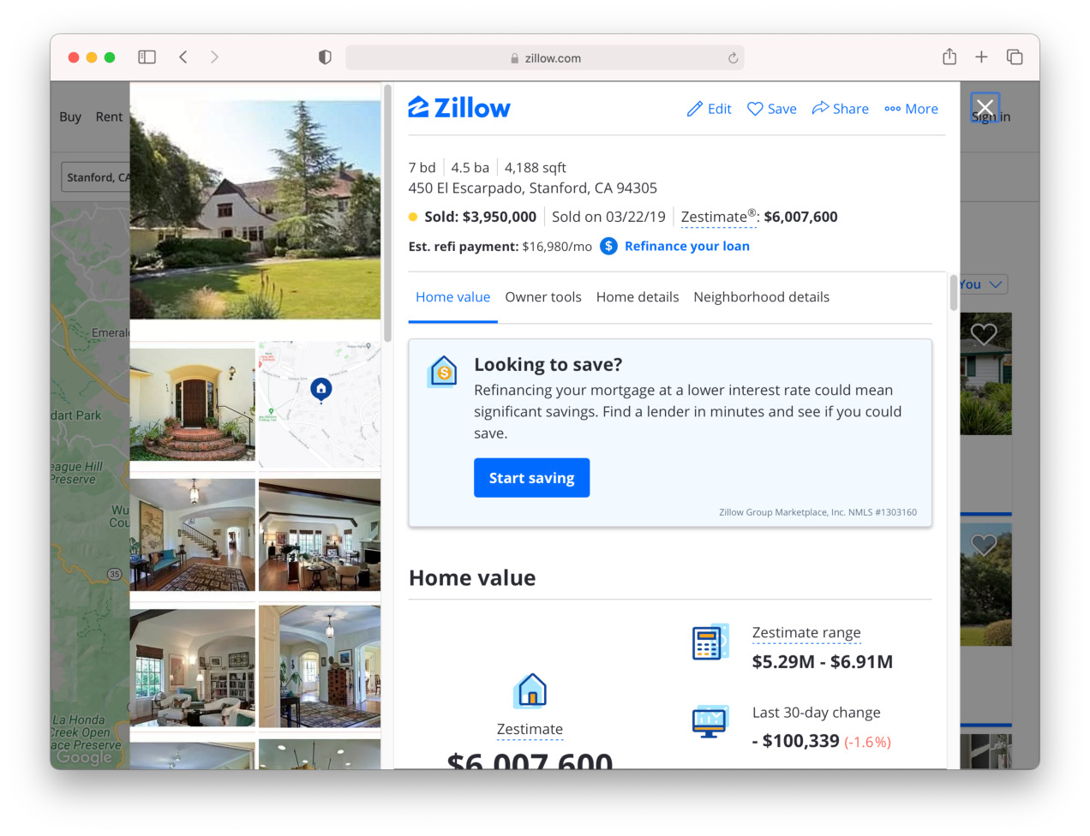
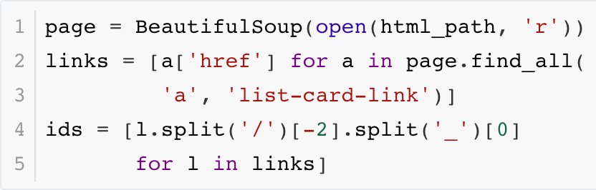
Craw individual pages
Get the house IDs from the index pages
The house detail page by ID
https://www.zillow.com/homedetails/ 19506780_zpid/

Slide 17
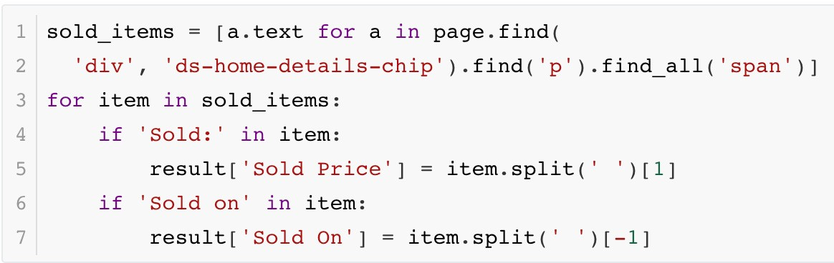
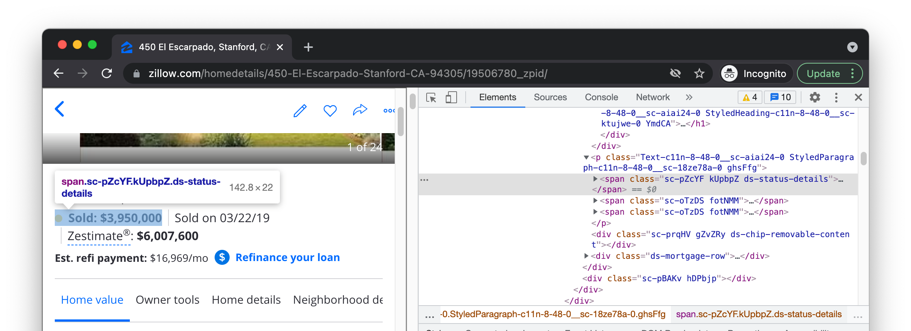
Extract data
Identify the HTML elements through Inspect

Slide 18
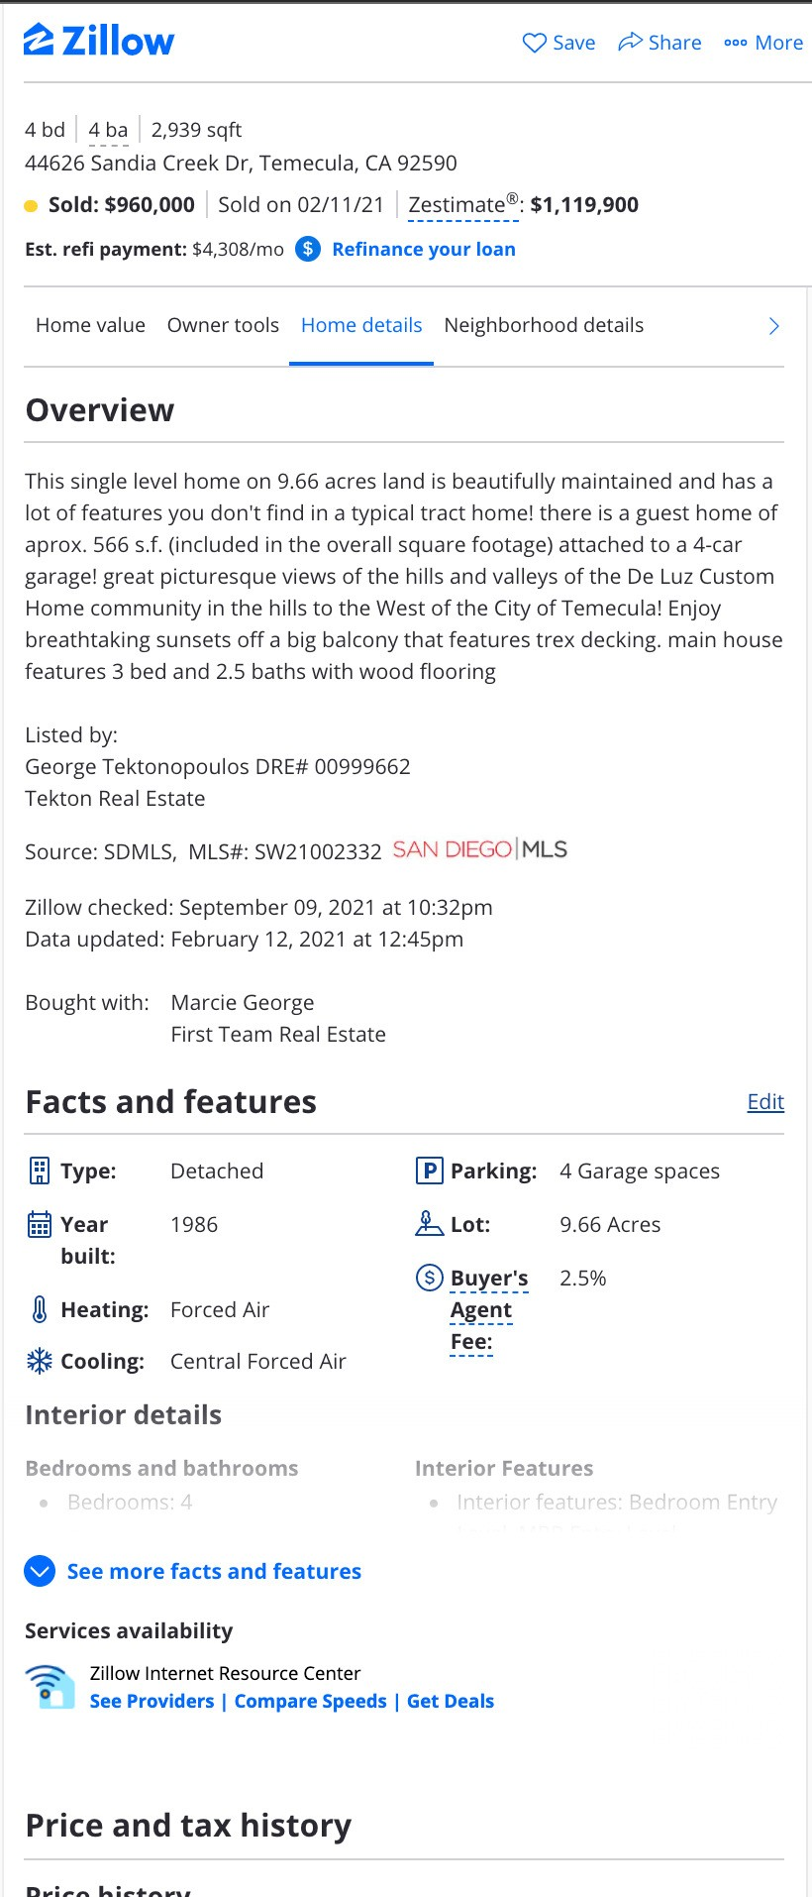
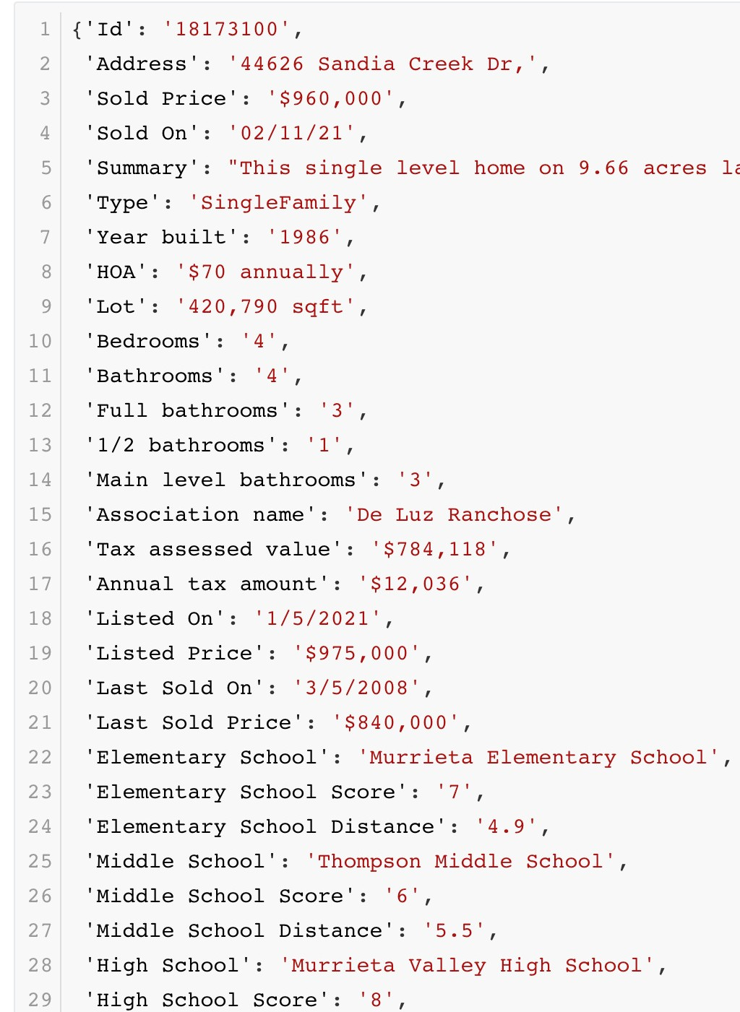

Extract data
Repeat the previous process to extract other field data

Slide 19
Cost
Use AWS EC2 t3.small (2GB memory, 2 vCPUs, $0.02 per hour)
2GB is necessary as the browser needs a lot memory, CPU and bandwidth are usually not an issue
The cost to crawl 1M houses is $16.6
The speed is about 3s per page （92 hours for 1M pages）,
The extra cost includes storage, restart instances when IP is banned

Slide 20
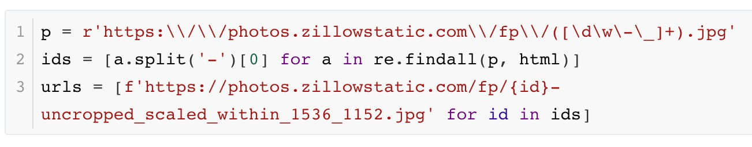
Crawl Images
Get all image URLs
A house listing has ~20 images
The crawling cost is still reasonable: ~$300
Storing these images is expensive: ~$300 per month
You can reduce the image resolutions, or send data back

Slide 21
Legal Considerations
Web scraping isn’t illegal by itself
But you should
NOT scrape data have sensitive information (E.g. private data involving username/password, personal health/medical information)
NOT scrape copyrighted data (E.g. YouTube videos, Flickr photos)
Follow the Terms of Service that explicitly prohibits web scraping
Consult a lawyer if you are doing it for profit

Slide 22
Summary
Web scraping is a powerful way to collect data at scale when the website doesn’t offer a data API
Low cost if using public clouds
Use browser’s inspection tool to locate the information in HTML
Be cautious to use it properly

Slide 23
Outline
Data Acquisition
Web Scraping
Data Labeling
Data Cleaning
Data Transformation
Feature Engineering
Data Part Summary

Slide 24
Flow Chart for Data Labelling
Add labels? Improve data representation
?
Enough label to start with ?
 | No
Use weak label?
Yes
Label
No
Enough
budget?
Have data?
No
Data
Yes
Yes
Covered before
Data preprocessing
Use semi- supervised learning
Label via crowdsourcing (众包)
Use weak supervision

Slide 25
Semi-Supervised Learning (SSL)
Focus on the scenario where there is a small amount of labeled data, along with large amount of unlabeled data
Make assumptions on data distribution to use unlabeled data
Continuity assumption: examples with similar features are more likely to have the same label
Cluster assumption: data have inherent cluster structure, examples in the same cluster tend to have the same label
Manifold assumption: data lie on a manifold of much lower dimension than the input space

Slide 26
Self-training
Self-training is a SSL method
Only keep highly confident predictions
 | 3. Merge
Labeled data
Pseudo-labeled data
Models | 2. Predict
1. Train
Unlabeled data
We can use expensive models
Deep neural networks, model ensemble/bagging

Slide 27
Label through Crowdsourcing
ImageNet labeled millions of images through Amazon Mechanical Turk. It took several years and millions dollars to build
According to Amazon SageMaker Ground Truth, the estimated price of using Amazon Mechanical Turk:
Image/text classification | $0.012 per label
Bounding box | $0.024 per box
Semantic segmentation | $0.84 per image

Slide 28
Challenges
Simplify user interaction: design easy tasks, clear instructions and simple to use interface
Needs to find qualified workers for complex jobs (e.g. label medical images)
Cost: reduce #tasks X #time per task sent to labelers
Quality control: label qualities generated by different labelers vary

Slide 29
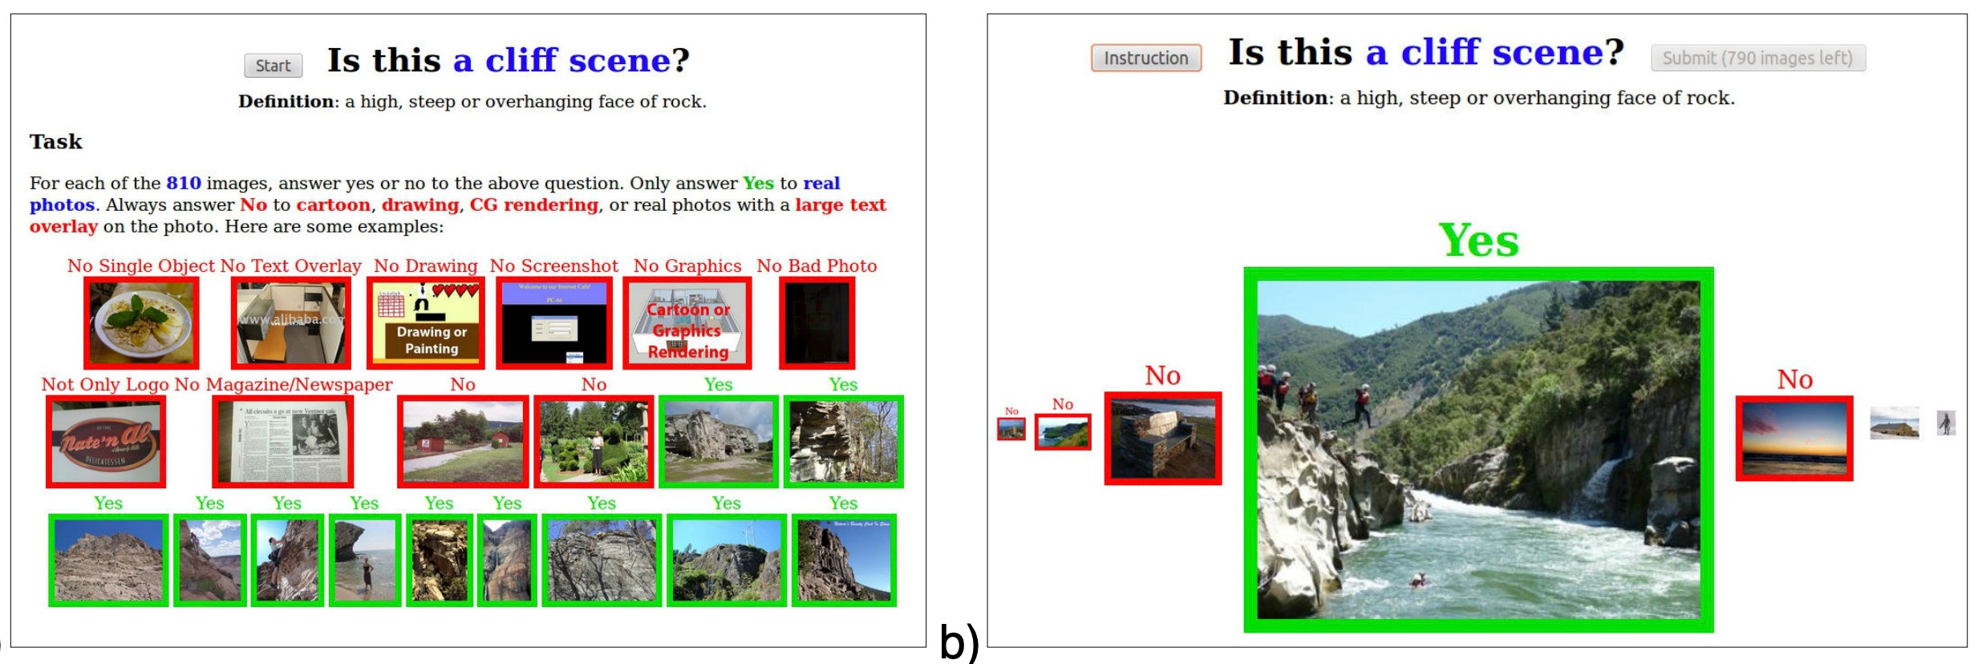
User interaction
Example of user instruction and labeling task (MIT Place365)

Slide 30
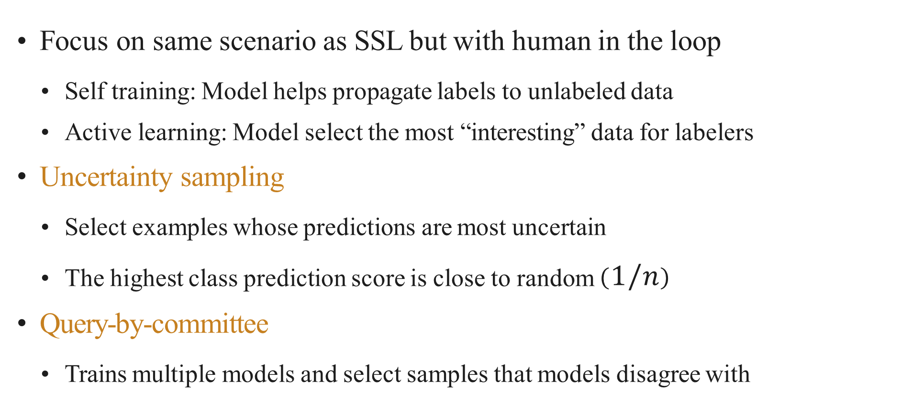
Reduce #tasks: Active Learning
Focus on same scenario as SSL but with human in the loop
Self training: Model helps propagate labels to unlabeled data
Active learning: Model select the most “interesting” data for labelers
Uncertainty sampling
Select examples whose predictions are most uncertain
The highest class prediction score is close to random $(1/n)$
Query-by-committee
Trains multiple models and select samples that models disagree with

Slide 31
Active Learning + Self-training
These two methods are often used together
Labeled data
4. Merge
Pseudo- labeled data
Labeled by Labelers
3. Most confident
1. Train
Models
3. Lest confident
2. Predict
Unlabeled data

Slide 32
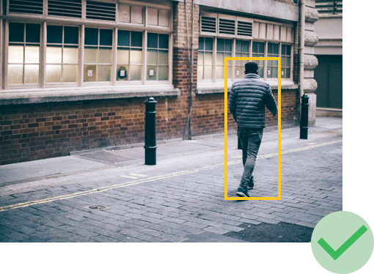
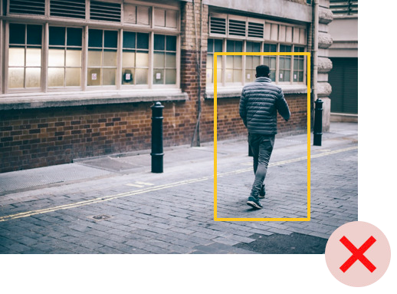
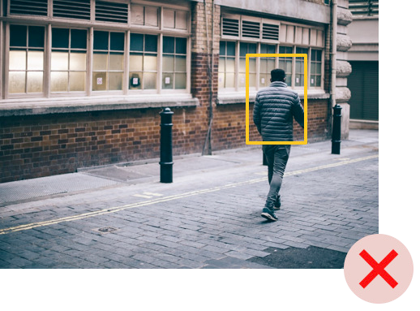
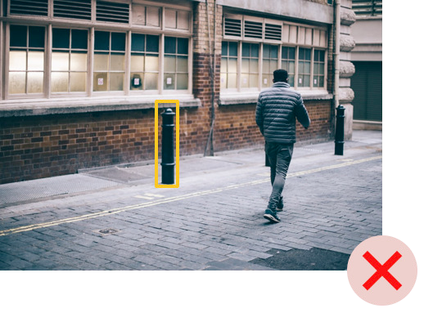
Quality Control
Labelers make mistakes (honest or not) and may fail to understand the instructions
Too big Too small Wrong object
Simplest but most expensive: sending the same task to multiple labelers, then determine the label by majority voting
Improve: repeat more for controversial(有争议的) examples, prune low-quality labelers

Slide 33
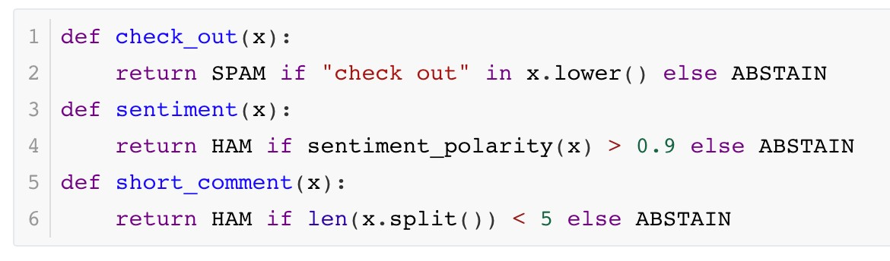
Weak Supervision
Semi-automatically generate labels
Less accurate than manual ones, but good enough for training
Data programming:
Domain specific heuristics to assign labels
Keyword search, pattern matching, third-party models
E.g. rules to check if YouTube comments are spam
Adapted from snorkel.org

Slide 34
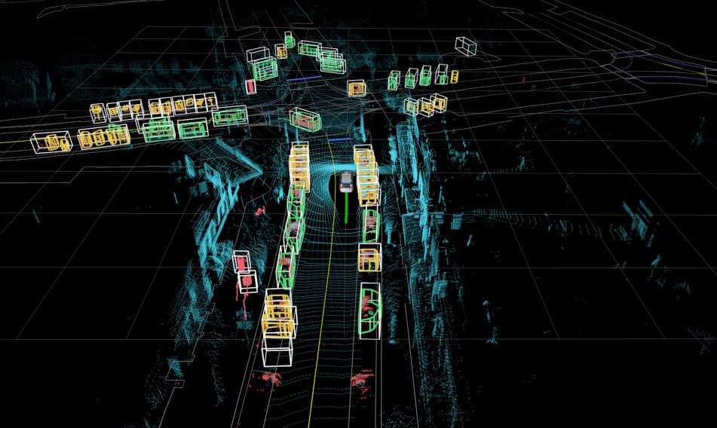
Data Labeling for Self-driving Car
Tesla and Waymo both have large in-house data labeling teams
Labels needed: 2D/3D bounding box, image semantic segmentation, 3D laser point cloud annotation(3D激光点云标注), video annotation,…
Use active learning to identify scenarios which need more data / label
Use ML algorithms for automatic labeling
Use simulation to generate perfectly labeled, unlimited data for rare situations

Slide 35
Summary
Ways to get labels
Self-training: iteratively train models to label unlabeled data
Crowdsourcing: leverage global labelers to manually label data
Data programming: heuristic programs to assign noisy labels
Alternatively, You could also consider unsupervised/self- supervised learnings

Slide 36
Flow chart for data preprocessing
Not in a model preferred format?
 | No
Have enough data?
Yes
Improve Label, data, or model?
Data
No
Very noisy?
Hard to learn?
No
Label Model
Yes
Yes
Yes
Data transformation
Feature engineering
Covered before
Will cover later
Data cleaning

Slide 37
Outline
Data Acquisition
Web Scraping
Data Labeling
Data Cleaning
Data Transformation
Feature Engineering
Data Part Summary

Slide 38

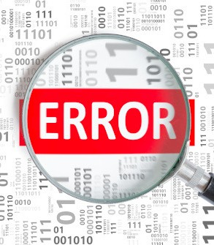
Data Errors
Data often have errors - the mismatch with ground truth (missing, erroneous or extreme values)
Good ML models are robust to errors
DNN trained with SGD; Decision trees
Consequences:
The training may still converge, but slower
Accuracy degradation, could be hard to detect
Deploying these models may impact the quality of the new collected data
e.g. positive examples generated by poor recommendation / search results

Slide 39
Types of Data Errors
Outliers: data values that significantly deviate from other observations
outliers VS under sampled rare events
Rule violations: data values violate integrity constraints(完整性约束) such as “Not Null” and “Must be unique” and “Non negative”
Pattern violations: data values violate syntactic and semantic constraints(句法语义约束) such as formatting, misspelling

Slide 40

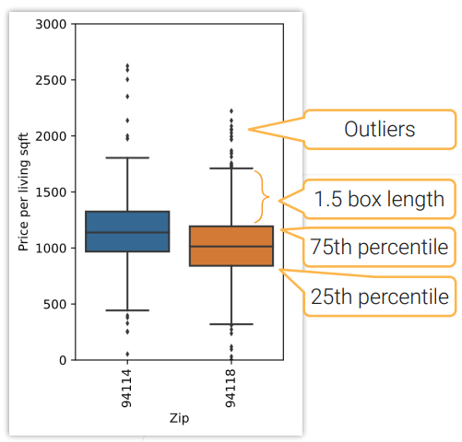
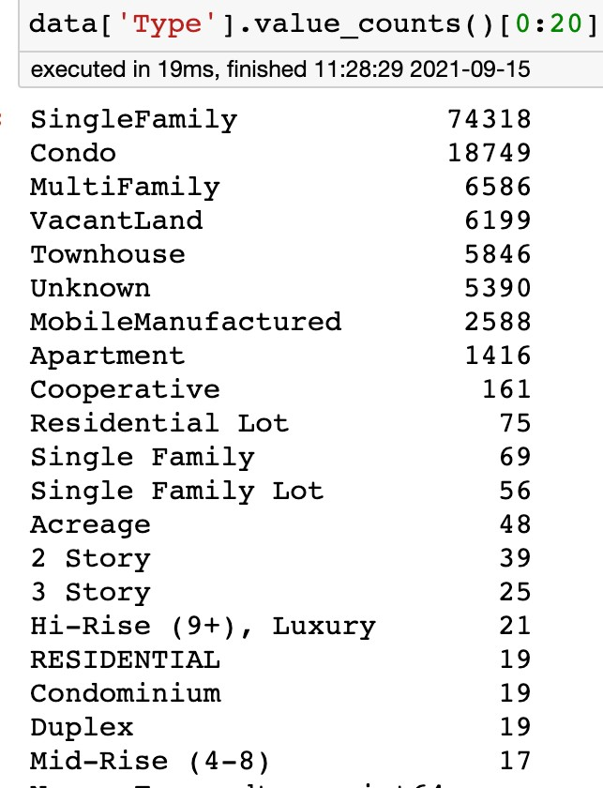
Outlier Detection
}Outliers

Slide 41
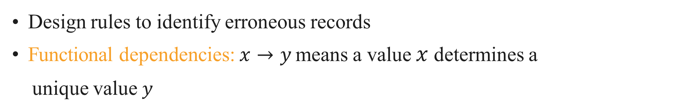
Rule-based Detection
Design rules to identify erroneous records
Functional dependencies: $x→y$ means a value $x$ determines a
unique value $y$
E.g. zip code → state
Denial constraints: specified with more flexible first-order logic
If two captures of the same animal indicated by the same tag number, then the first one must be marked as original

Slide 42
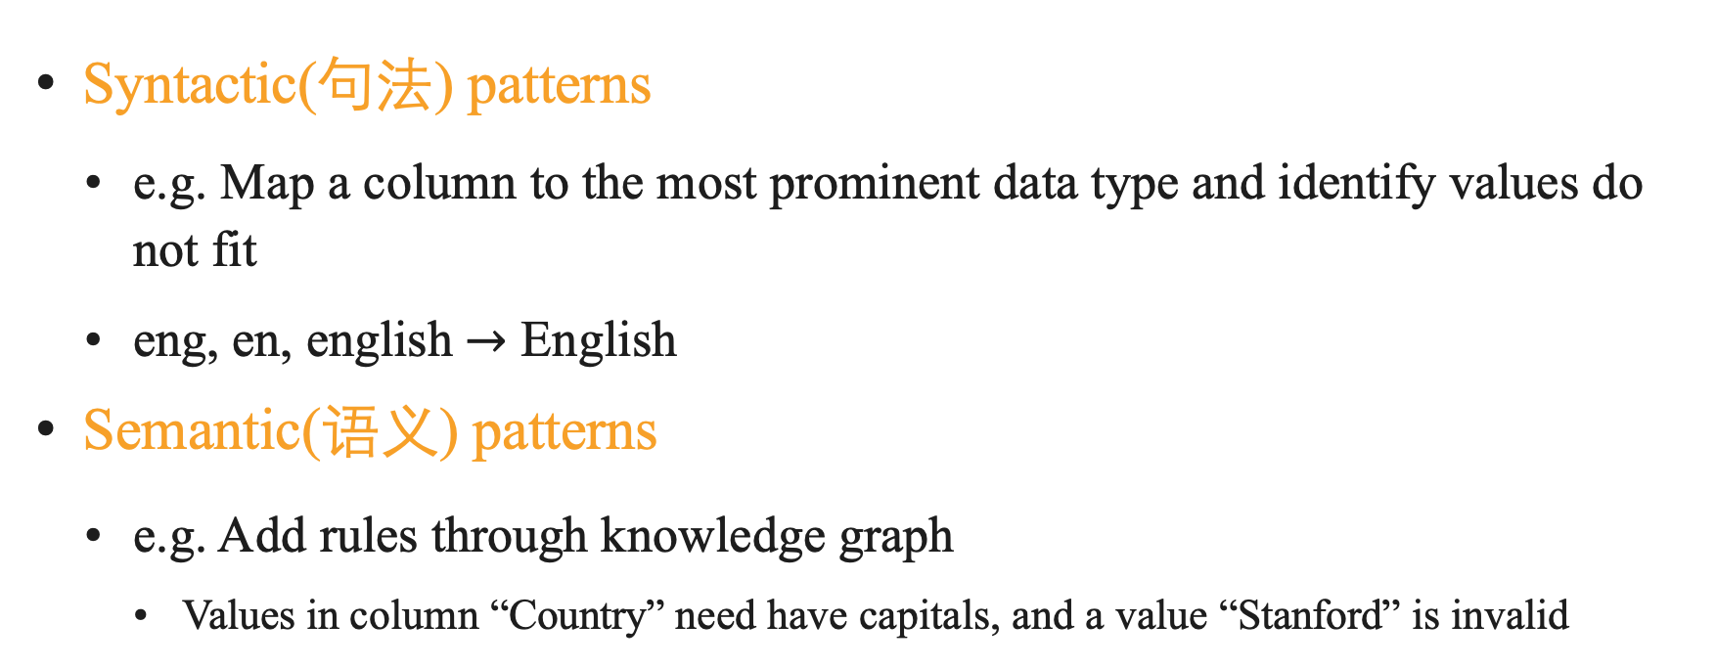
Pattern-based Detection
Syntactic(句法) patterns
e.g. Map a column to the most prominent data type and identify values do not fit
eng, en, english $→$ English
Semantic(语义) patterns
e.g. Add rules through knowledge graph
Values in column “Country” need have capitals, and a value “Stanford” is invalid

Slide 43

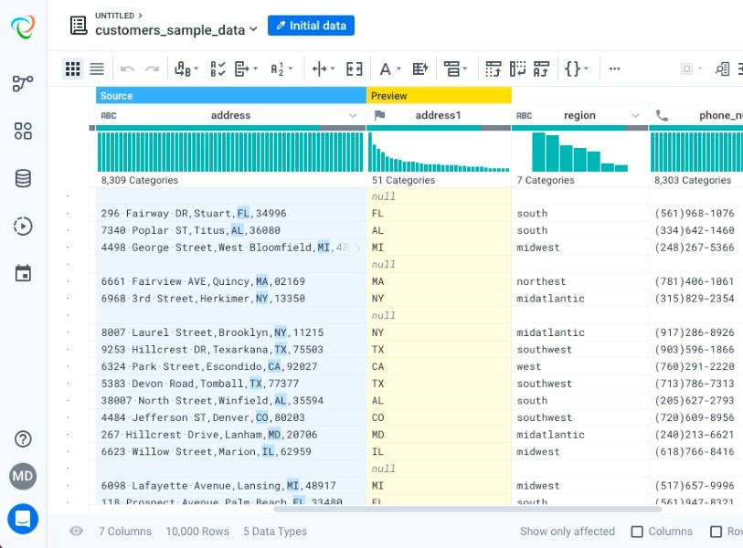
Summary
Types of data errors: outliers, rule violations, pattern violations
Multiple tools exist to help data cleaning
Graphic interface for interactive cleaning
Automatically detect and fix
Trifacta Wrangler

Slide 44
Outline
Data Acquisition
Web Scraping
Data Labeling
Data Cleaning
Data Transformation
Feature Engineering
Data Part Summary

Slide 45
Data Transformation
ML algorithms prefer well defined fixed length, well-conditioned, nicely distributed input
Next, data transformation methods for different data types
Data Transform-ation
Daw data collecting
Labelling & cleaning
Feature engineering
Model training

Slide 46
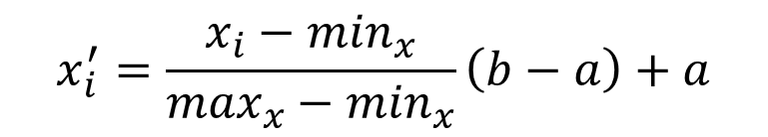
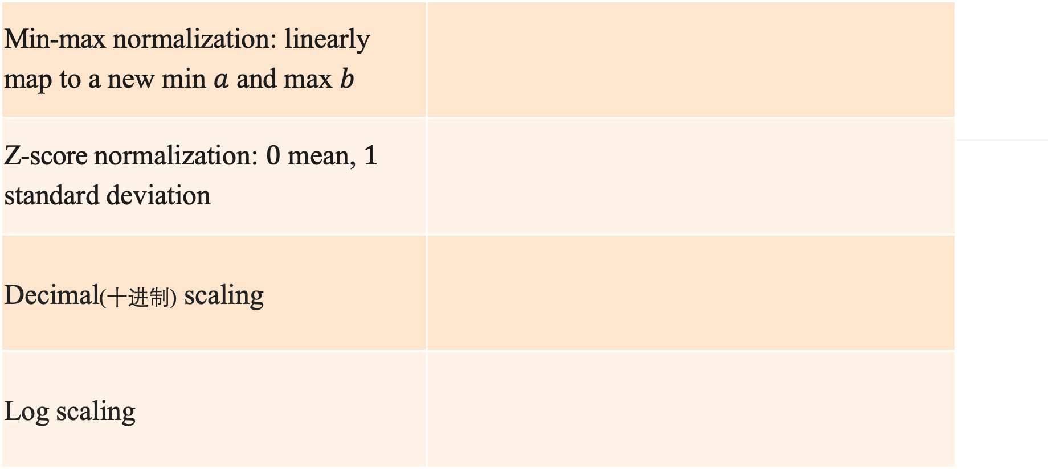

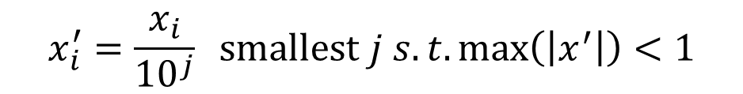
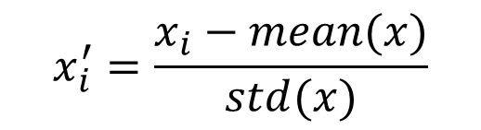
Normalization for Real Value Columns
Normalization makes training more stable
Min-max normalization: linearly
map to a new min $a$ and max $b$
Z-score normalization: $0$ mean, $1$
standard deviation
Decimal(十进制) scaling
Log scaling
$$x_{i}^{′}=\frac{x_{i}−\min_{x}}{\max_{x}−\min_{x}}\left(b−a\right)+a$$
$$x_{i}^{′}=\frac{x_{i}−mean(x)}{std(x)}$$
$$x_{i}^{′}=\frac{x_{i}}{{10}^{j}} smallest j s.t.\max\left(\left|x^{′}\right|\right)<1$$
$$x_{i}^{′}=log⁡(x_{i})$$

Slide 47

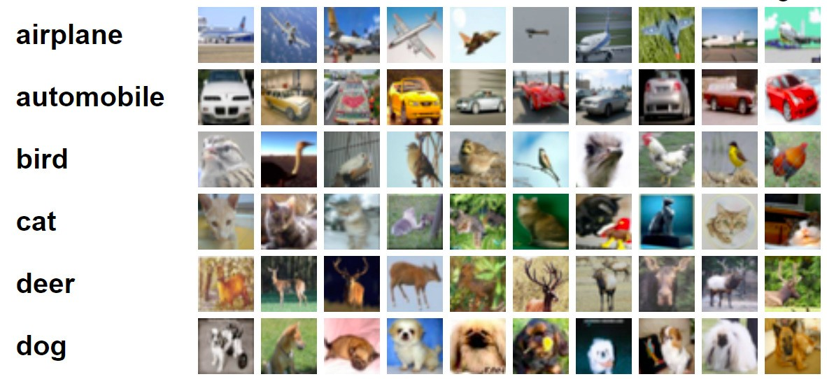
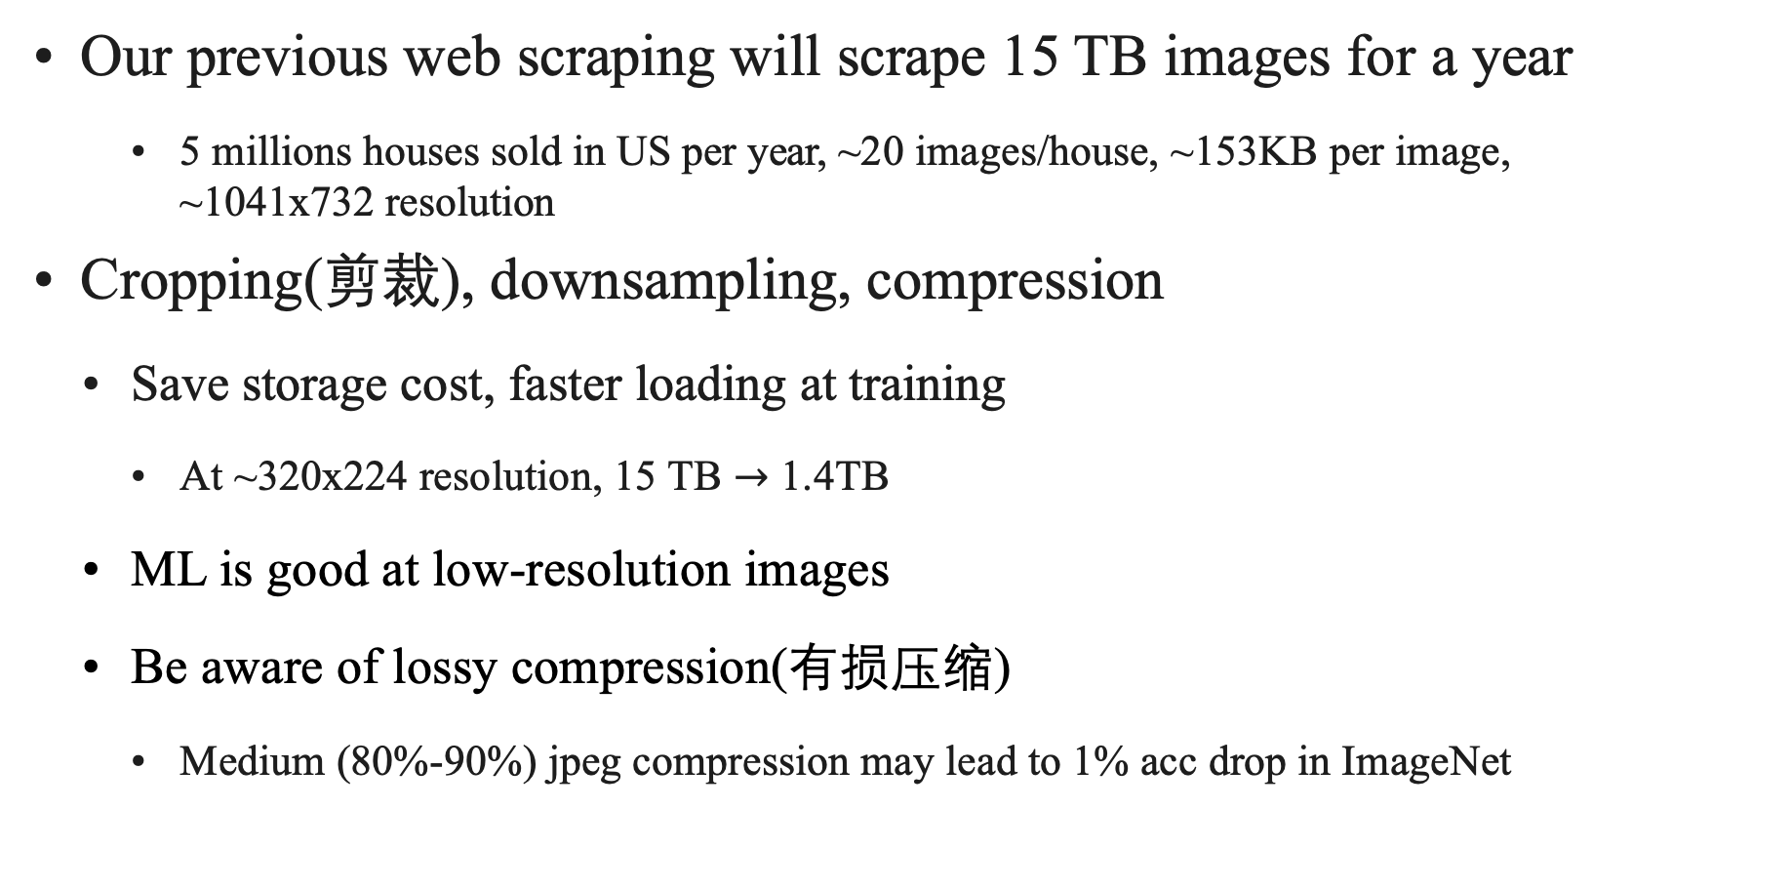
Image Transformations
Our previous web scraping will scrape 15 TB images for a year
5 millions houses sold in US per year, ~20 images/house, ~153KB per image,
~1041x732 resolution
Cropping(剪裁), downsampling, compression
Save storage cost, faster loading at training
At ~320x224 resolution, 15 TB $→$ 1.4TB
ML is good at low-resolution images
Be aware of lossy compression(有损压缩)
Medium (80%-90%) jpeg compression may lead to 1% acc drop in ImageNet
CIFAR-1

Slide 48
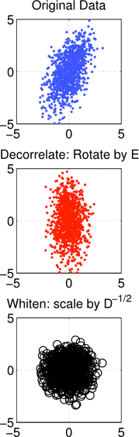
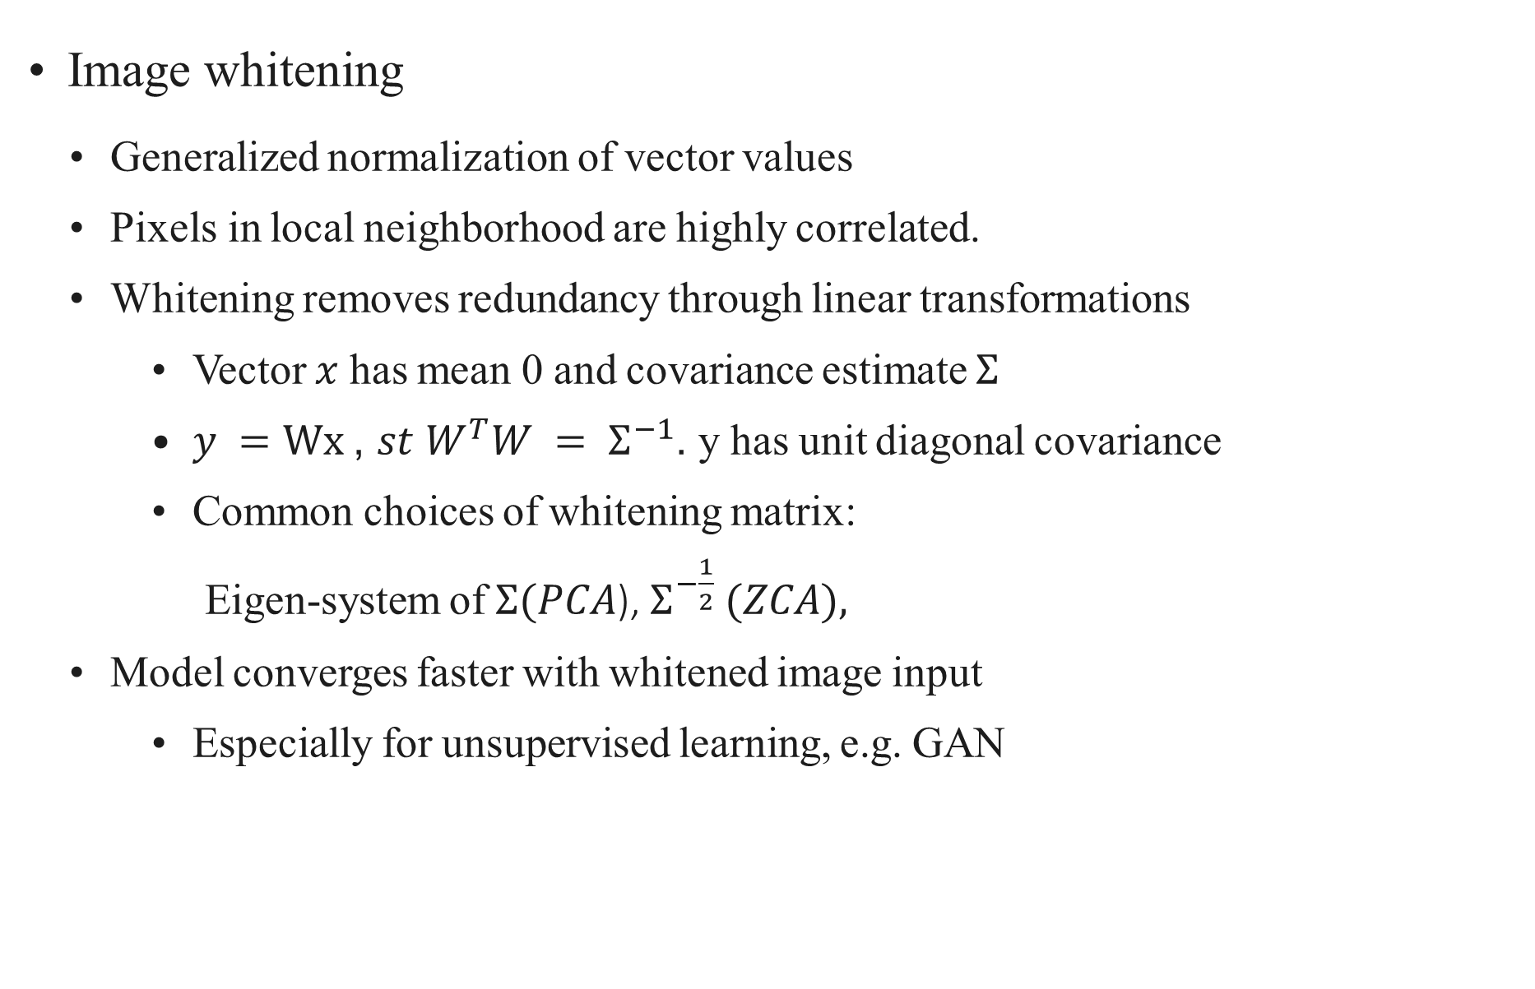
Image Transformations
Image whitening
Generalized normalization of vector values
Pixels in local neighborhood are highly correlated.
Whitening removes redundancy through linear transformations
Vector $x$ has mean 0 and covariance estimate $Σ$
$y =Wx$, $st W^{T}W = Σ^{−1}$. y has unit diagonal covariance
Common choices of whitening matrix:
Eigen-system of $Σ(PCA$), $Σ^{−\frac{1}{2}} (ZCA),$
Model converges faster with whitened image input
Especially for unsupervised learning, e.g. GAN
PCA whitening

Slide 49
Video Transformations
Input variability high
Average video length: Movies ~2h, YouTube videos ~11min, Tiktok short videos
~15sec
Tractable ML problems with short video clips (<10sec)
Ideally each clip is a coherent event (e.g. a human action)
Semantic segmentation is extremely hard..
Preprocessing to tradeoff storage, quality and loading speed
Common practice: decode a playable video clip, sample a sequence of frames, compute spectrograms(频谱图) for audio
Easy to load to model, increased storage space

Slide 50
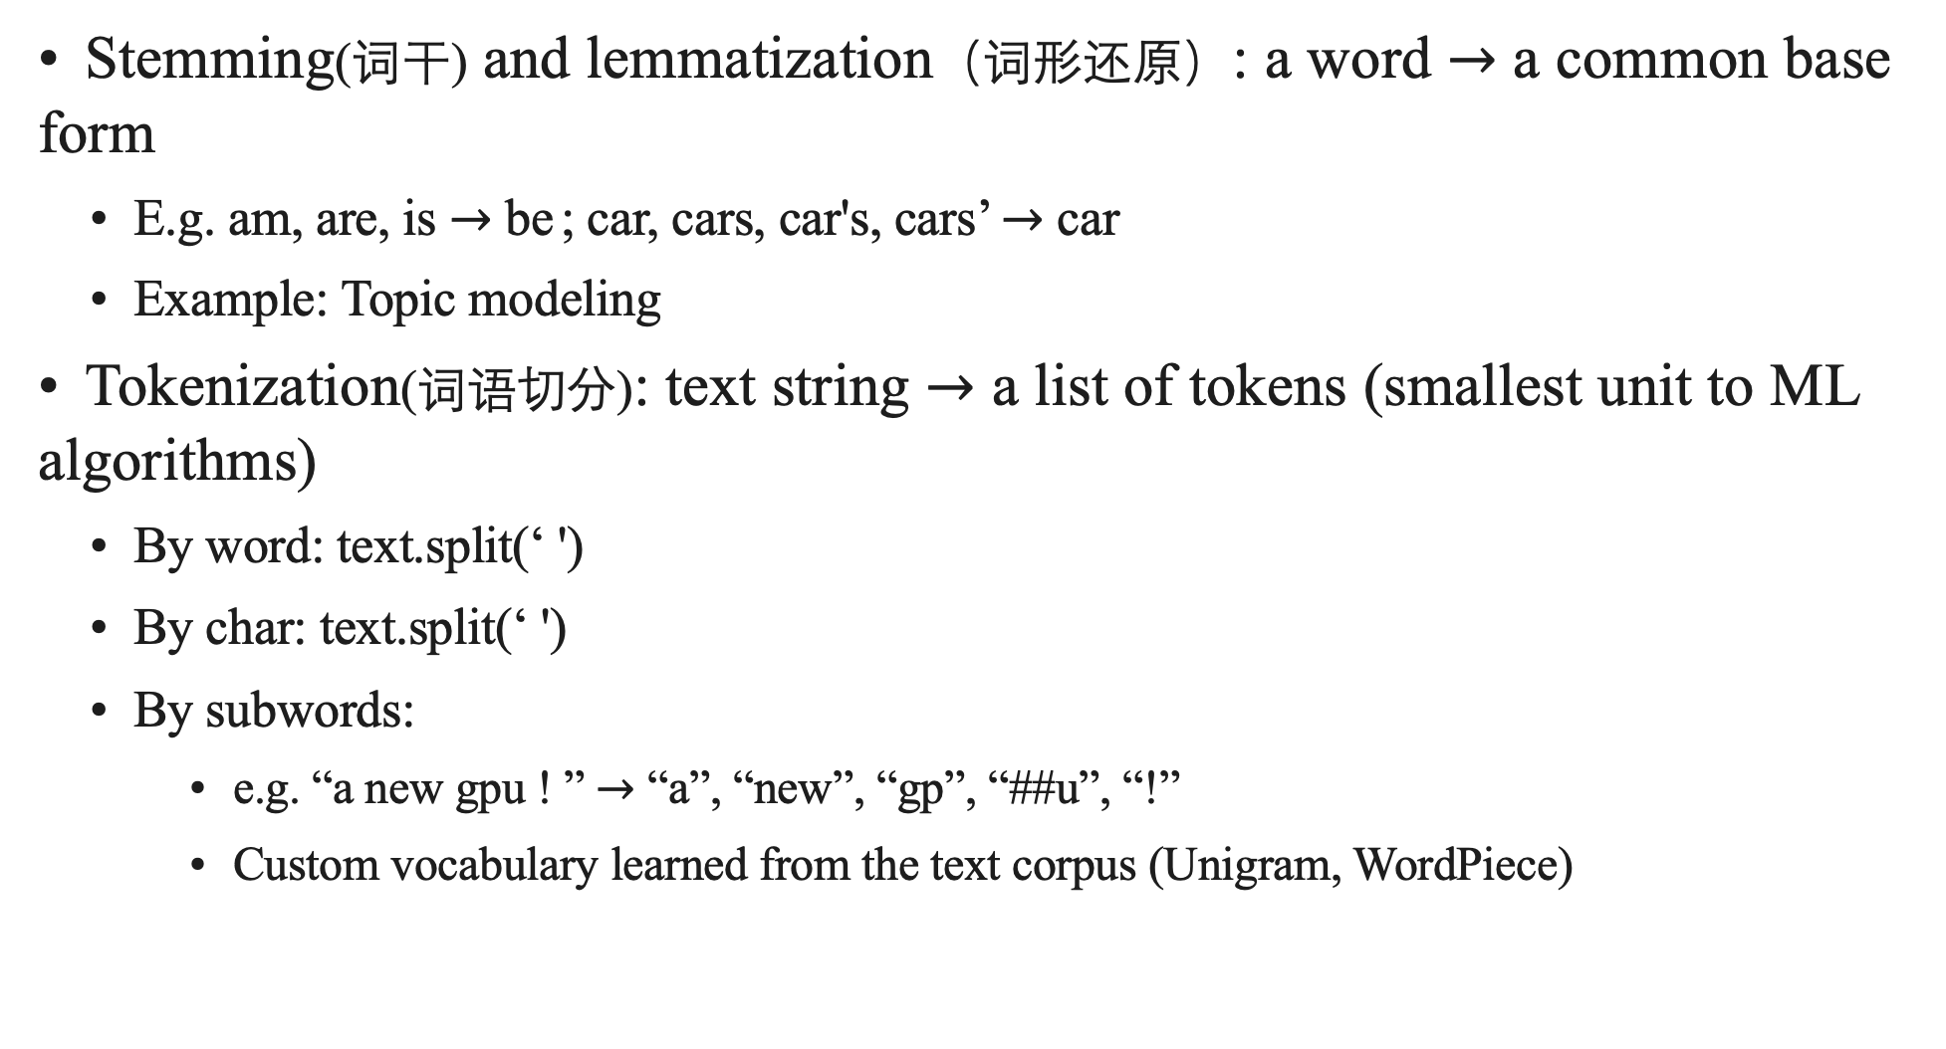
Text Transformations
Stemming(词干) and lemmatization（词形还原）: a word $→$ a common base form
E.g. am, are, is $→$ be ; car, cars, car's, cars’ $→$ car
Example: Topic modeling
Tokenization(词语切分): text string $→$ a list of tokens (smallest unit to ML algorithms)
By word: text.split(‘ ')
By char: text.split(‘ ')
By subwords:
e.g. “a new gpu ! ” $→$ “a”, “new”, “gp”, “##u”, “!”
Custom vocabulary learned from the text corpus (Unigram, WordPiece)

Slide 51
Summary
Transform data into formats preferred by ML algorithms
Tabular: normalize real value features
Images: cropping, downsampling, whitening
Videos: clipping, sampling frames
Text: stemming, lemmatization, tokenization
Need to balance storage, quality, and loading speed

Slide 52
Outline
Data Acquisition
Web Scraping
Data Labeling
Data Cleaning
Data Transformation
Feature Engineering
Data Part Summary

Slide 53
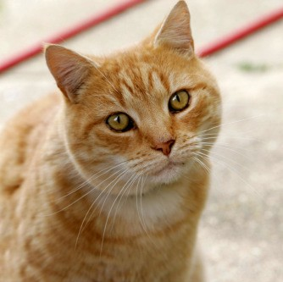
Feature Engineering
Before deep learning (DL), feature engineering (FE) was critical to using ML models
Traditional CV: detect corners / interest points..
DL train deep neural networks to automatically extract features
Train CNN to replace feature extractor
Features are more relevant to the final task
Limitation: data hungry, computation heavy
SVM
Softmax regression
Manually engineered features
Features learned by a neural network

Slide 54
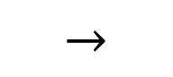
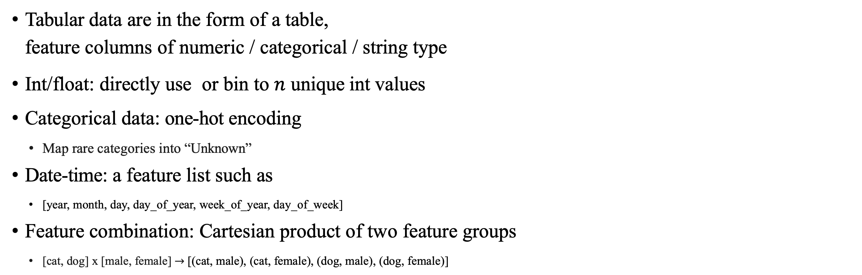
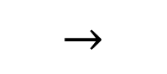
Tabular Data Features
Tabular data are in the form of a table,
feature columns of numeric / categorical / string type
Int/float: directly use or bin to $n$ unique int values
Categorical data: one-hot encoding
Map rare categories into “Unknown”
Date-time: a feature list such as
[year, month, day, day_of_year, week_of_year, day_of_week]
Feature combination: Cartesian product of two feature groups
[cat, dog] x [male, female] $→$ [(cat, male), (cat, female), (dog, male), (dog, female)]
unknown
fish
cat
and
dog
cat | [0, | 1, | 0, | 0, | 0]
dog | [0, | 0, | 0, | 1, | 0]
$$→$$
$$→$$

Slide 55
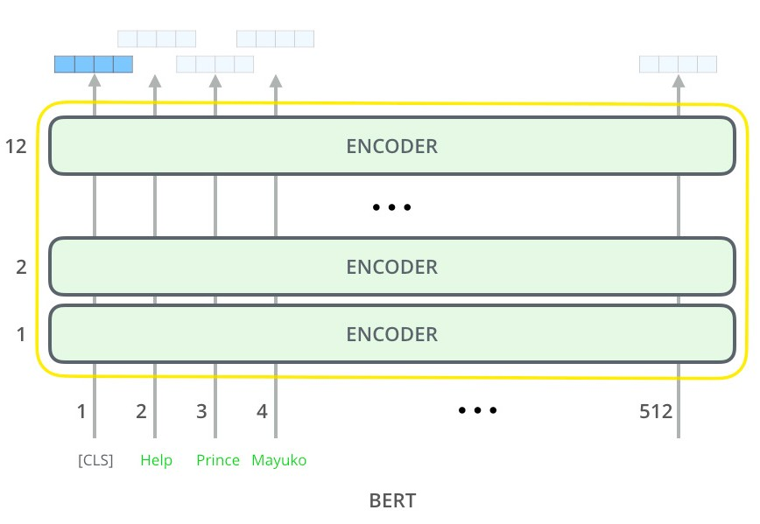
Text Features
Represent text as token features
Bag of words (BoW) model
Limitations: needs careful vocabulary design, losing context for individual words
Word Embeddings (e.g. Word2vec):
dog and cat and dinosaur
↓
unknown
fish
cat
and
dog
[0, 1, 2, 1, 1]
Vectorizing words such that similar words are placed close together
Trained by predicting target word from context words
Pre-trained universal(通用的) language models (e.g. universal sentence encoder, BERT, GPT-3)
Giant transformer models
Trained with large amount of unannotated data
Usage: Text embedding; fine-tuning for downstream tasks
Image credit: Jay Alammar

Slide 56
Image/Video Features
Traditionally extract images by hand-craft features such as SIFT(scale-invariant feature transform，一种图像局部特征提取的方法)
Now pre-trained deep neural networks are common used as feature extractor
ResNet: trained with ImageNet (image classification)
I3D: trained with Kinetics (action classification)
Many off-the-shelf models available
Softmax regression
Image features
Pre-trained CNN

Slide 57
Summary
Features are representations of raw data that are relevant to the target task
Feature engineering VS Feature learning
The latter is preferred if available (images/videos/audio/text)

Slide 58
Outline
Data Acquisition
Web Scraping
Data Labeling
Data Cleaning
Data Transformation
Feature Engineering
Data Part Summary

Slide 59
Flow chart
Exploratory data analysis
Data cleaning
Data transformation
Feature engineering
Start a DM/ML application
Will cover later
Data Preprocess-ing
Model
Have enough data?
Data
Yes
Improve Data, Label or Model ?
An iterative process
No
Label
Semi- supervised learning
Label via crowdsourcing
Weak supervision
Data Labeling
Discover/ augment data
Generate data
Collecting Data

